Slide 1


Entrepreneurship: What is it?
A High-Schooler’s Guide
What does it take? Is it for you? How to start?
This presentation is available on the www.CxO-Atlas.com website. Article 8.040314
October 16, 2026
Tom Berger | RDK Consulting, Inc. | tom@rdkgroup.com
Notes:
Thank you for giving me the opportunity to speak with you today. My comments reflect my personal experiences and what I have observed in working with over 170 entrepreneurs and small private companies over the years. My goal is simple: To help you understand what it takes to be an entrepreneur and what you can do now to start the journey. Your primary goal is to continue with your education. Think of entrepreneurship as a learning experience that can help you understand what you need to do later.
When I work with entrepreneurs, I tell them: “Listen to everything that I have to say but certainly do not DO everything that I tell you to do!” Everyone’s circumstances are different, and each person has to decide for themselves what path they will choose.
I have made many mistakes over my career and have observed many others. I have also done some things right and have seen many entrepreneurs succeed. This presentation aims to provide you with some suggested activities to help you become a successful entrepreneur.

Slide 2

When We Think of Entrepreneurs…
We might think of…
Of the 34M companies in the US…
Mark Zuckerberg: Meta (Facebook)
70% have no employees
95% have nine of less employees
80% of all companies have annual revenue less than $5 million
Only 0.07% have > 500 employees
Elon Musk: PayPal, Tesla, SpaceX
Bill Gates: Microsoft
Jeff Bezos: Amazon
Jensen Huang: NVIDIA
Larry Page & Sergey Brin: Google
There is room for the rest of us!
Sam Altman: OpenAI
But there are plenty of others!
Notes:
The headlines are full of stories about the mega companies and their founders or CEOs. It is easy to imagine ourselves as the next billionaire like these individuals based on our super-duper idea. It is similar to imagining you have won the lottery. There are billionaire entrepreneurs just like there are giant lottery winners – the odds are about the same.
Keep in mind that companies with 500 or more employees represent only 0.07% of all US companies. Entrepreneurs started the other 99.9% and most are still run by them.

Slide 3
Transitions
You are already here!
Entrepreneurship
?
Avocation
Vocation
Pass Time
Hobby
Part Time
Lifestyle
Exit Focused
Browsing
Sports Watching
Museums
Concerts
Woodworking
Collecting
Sewing
Coding
Selling Crafts
Consulting
Subject Matter Expert
Dry Cleaner
Franchiser
Online Selling
Personal Srvc
Offering Products or Services to a
Large Mkt
Examples
Focus
Yourself
Yourself
“Local” Mkt
“Local” Mkt
Mass Mkt
Commitment
Minimal
Minimal
Intermittent
Heavy
Total
Time Req’d
Casual
Casual
Variable
40 Hrs ++
> 7 x 24!
Investment $
(Almost) Free
Low to Hi $
Low to Med $
Med to Hi $
Hi to Very Hi $
Income
None
None
Some
Sufficient
None to Large
Satisfaction
Now
Now
Now
Now
Later
Notes:
You have already started down the entrepreneurial path! You have hobbies, likes, and dislikes. As you grow, some of them may turn out to be areas that you may want to pursue later. There are differences during each phase. Also, phases may overlap. In fact, they almost certainly will! For example, even the busiest corporate executive will continue to have pastime activities and hobbies.
Sometimes, Lifestyle businesses do exist. Some entrepreneurs pursue their dream with no intent to start with a Lifestyle business. An effective strategy for either a Lifestyle or Exit-Focused business is to have the attitude that you will run it forever. If, however, someone offers to buy your business along the way, you can decide what is best for you.
Contrast that approach with the entrepreneurs during the dot-com bubble, and perhaps today in the “AI bubble,” who started their companies only to flip them as soon as possible. Most fail because they did not take the time to build a strong foundation.

Slide 4

Why Become an Entrepreneur?
Ready to be his/her own boss: 28%
Dissatisfied with corporate life: 22%
Wanted to pursue his/her passion: 13%
Laid off or outsourced: 10%
The opportunity presented itself: 9%
Wanted to create a legacy: 9%
Other: 9%
“Running Away”
Starts with an Idea
Probably moving up
“Running To”
to do something different
“Become Rich”
4
Notes:
These statistics are interesting and not what seems to be the common belief that has spread across the Internet about becoming rich. It happens; so does someone win the lottery. With today’s economy in a rather unstable condition and the wild speculation about the impacts of AI, many individuals are looking for a safe harbor. Starting their own company and being their own boss looks very appealing. However, the path to success is far from easy or straightforward. In fact, most startups fail. In fact, 22% fail in the first year, 49% fail within five years, and 65% fail within ten years. Even with those disappointing statistics, most entrepreneurs report that they are not sorry for trying.

Slide 5

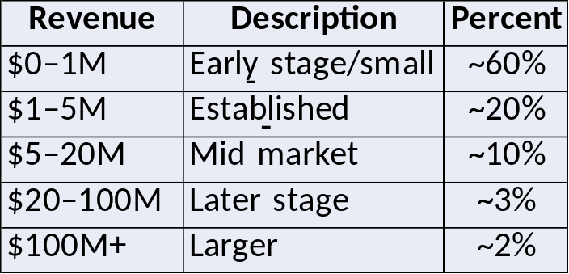
Who is an Entrepreneur?
MY DEFINITON
“Someone who runs a company.”
( OR Someone who doesn’t work for someone else.)
Started it
Inherited it
Bought it
Hired to run it
One Time Revenue
Recurring Revenue
High Tech
Low Tech
> 34 Million Private US Businesses fit this definition.
Only about 6% are classified as “high-tech.”
Existing Markets
New Markets
Full-Time
Part-Time
There are only 3,714 US Public companies.
Providing:
A product or
A service
Although high-tech and public companies get the headlines, there are far more other opportunities.
Alone
With Partners
With Employees
For-Profit
Non-Profit
Offering:
Better or
Innovative
Businesses Started in 2025:
5.6 Million in the Us
254,582 in Georgia
49,873 in Fulton County
>80%
Many Take the Plunge!
Notes:
This slide is my definition. It is obviously overly broad. However, virtually everyone running their own business needs many of the same traits as a new entrepreneur. We live in a highly competitive world. The skills needed to start a company successfully are still required years down the road.
Although giant public companies and high-tech startups seem to get all the headlines, the vast majority of businesses are neither. Simple ideas are simply better!

Slide 6
What’s Behind My Definition?
Direct
Indirect
Every Business:
Entrepreneur or CEO
Large or Small
New or Old
Low Tech/High Tech
Consumer/Enterprise
Solution Development
Billing
Needs all of these
Marketing
Customer Support
Advertising
Finance
For every company, the only differences are:
How much effort and resources for each category?
When should the efforts begin?
Selling
Accounting
Fulfilling Orders
Legal
Entrepreneurs need to think about all these items – when the time is right.
Supporting Customers
H/R
Notes:
The activities on the slide drive home the point about what everyone running a business needs to embrace. Think of the items listed as the variables in the success equation, which is the same for every business. What differs are the two coefficients associated with each variable. They are the effort required and when it's required.
Two extreme examples illustrate this concept.
An App Store application may be developed by a sole entrepreneur in weeks and launched quickly with only some social media advertising. Fulfilling orders and supporting customers' efforts are almost non-existent.
Developing a robot for home use, on the other hand, will take 1,000s of hours of effort for design and manufacturing, followed by significant distribution and customer support activities.
Most product and service offerings will fall somewhere in between.

Slide 7
What is an Entrepreneur?
“More Official” Definition
An entrepreneur is an individual who identifies a need in the marketplace and works to fulfill it.
“They see an Opportunity”
“A set of circumstances that makes it possible to do something.”
Solve an existing problem
Improve an existing condition
Introduce an innovation
Notes:
This is a useful definition of an entrepreneur. Their observations lead to identifying an opportunity that can involve solving a recognized problem or improving an existing condition. Exciting opportunities often involve introducing an innovation or solution that can never been applied to the focused market segment.

Slide 8


What Makes An Entrepreneur Different?
An entrepreneur sees
what others don’t see
and
Takes action
Moves from Observer to Do’er
It starts with identifying a problem or condition and the feeling you can do something about it and want to!
could be “better” or “innovative”
Notes:
Individuals likely to pursue entrepreneurship often have the trait of “Seeing what others don’t see” as their major differentiator. Note that “seeing” is not enough. They must also be willing to take action.
In many cases, the solution to a problem may not be obvious. It often takes many iterations to “get it right.” Seldom is the first idea the one that leads to success.

Slide 9


The REAL problem may not be what you see!
Ask and Probe
What you heard or saw
What’s below the surface and not obvious?
Notes:
The old line that “things may be not be as they seem” could have been first said by an entrepreneur who stumbled! The iceberg analogy is fitting. The symptoms, not the real problem, are often the most obvious. Solving them may be like putting a Band-Aid on a ruptured artery. It will hide the bleeding for only a little while. Looking deeper is essential.
The same is true for the improvement of an existing condition. The quick response from others may be “it has always been done that way.” However, new technology or even considering the condition with a different perspective may be sufficient.

Slide 10


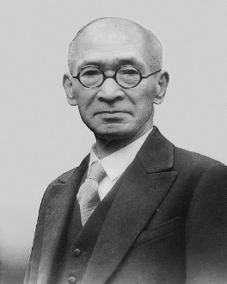
The “Route to the Root”
The Five Why’s
Ask “Why” five times to determine the root cause of a problem or failure.
Sakichi Toyoda
The “Route”
Identified Defect or
Problem
Why?
Why?
Why?
Why?
Root
Cause
Eliminate the root cause
Do not just “fix” the current problem
10
Notes:
The simple Five Why’s technique, developed by the Founder of the Toyota Motor Company, has almost universal applicability. Anyone can apply the technique, and it does not require specific expertise in the issue being discussed.
So many times, for various reasons, people respond with a quick but often short and simplistic answer to a question. It might be convenient, but it is hardly informative. An example is what happens every day on TV when a Wall Street “Expert” is asked what happened to the market yesterday. They are likely to respond with a two-word answer such as “Profit Taking,” or “Market Adjustment,” or “Market Correction.” However, when asked about tomorrow, they may go on and on without saying anything concrete.
During customer discovery, sincerely asking why and then carefully listening to the responses can provide remarkable insight.

Slide 11
5 Why’s Example
“Why were you late?”
The car wouldn’t start
The battery was dead
The alternator didn’t charge it
The alternator belt was broken
The belt was beyond its useful life
The car was not maintained properly
Why?
Why?
Why?
Why?
Why?
The problem was with the Owner not the Car!
11
Notes:
This is a classic example from the Internet. It illustrates that the issue was with the owner, not the vehicle! Implementing the technique is very simple.
Them: Sorry, I am late; my car wouldn’t start.
You: I am sorry to hear that your car didn’t start. Do you know why?
Them: The battery was dead.
You: Too bad that the battery was dead. Do you know why?
Them: The mechanic told me it wasn’t charged?
You: Hmmm, why wasn’t the battery being charged?
Note that you do not need to know anything about cars to probe. Also, the other person’s comments lead to the questions you need to ask. The more they talk, the more you learn.

Slide 12


Problems are Everywhere
Ask
How was your day?
What frustrates you?
If you could change on thing…
We have lots of used sports equipment that we don’t use anymore.
What is AI and should I be using it?
I wish there was someone who could fix my PC.
What is ChatGPT?
I am having lots of trouble with pre-calculus.
We can’t find babysitters.
Watch and Listen
I need lawn work done while I am away.
I need my hair done for the dance.
My daughter needs help with soccer.
Notes:
Often, would-be entrepreneurs struggle to find a business idea. Often, it is remarkably easy. All one has to do is look around and ask! As a quick test, ask yourself these simple questions. Don’t be surprised if your business idea jumps out at you.

Slide 13


Pick One
We have lots of used sports equipment that we don’t use anymore.
I wish there was someone who could fix my PC.
What is AI and should I be using it?
What is ChatGPT?
I am having lots of trouble with pre-calculus.
Interests you
You know about
Think you can address
Have an idea on how to explore it
We can’t find babysitters.
I need my hair done for the dance.
My daughter needs help with soccer.
I need lawn work done while I am away.
Notes:
Listen and observe what your simple investigation has uncovered. You'll likely move from not knowing what to pursue to having too many possibilities! Apply the four criteria to help you select one. Be realistic: curing cancer, developing a human teleporting system, or stable cold fusion would be incredible problems to solve, but…

Slide 14


Beware!
I have a solution, what can I fix?
Table Stakes!
Ensure you have the
Proper Product-Market Fit!
You must identify the problem and market first!
If not, you will probably “force” your solution into a problem.
One without the other won’t work!
14
Notes:
Unfortunately, I have seen this situation far too often. A would-be entrepreneur has developed “something” and then starts looking for a place or situation to sell it. Today, countless people have become familiar with AI and are now trying to sell their ability to develop “something.” I hear the pitch all the time: “I know AI; how can I apply it for you.”
The best way to start is through a pragmatic approach to matching a product or service to a market. Both must be well thought-out. One without the other leads to frustration, not success.

Slide 15




Identify the Solution to the Problem you have identified, Then…
1
2
3
4
Then Ask…
Investigate
Talk to Others and do Research
Put your solution aside
Notes:
Determining proper product-market fit follows a simple four-step process. It is simple but seems hard to follow.
After the problem and your solution have solidified in your head, you must set your solution aside and focus on whether others see the problem the same way you do AND feel it needs to be solved. To illustrate this point, think about some of the difficulties you regularly encounter. How many could be solved but you have decided not to take the time or make the effort to resolve them – there are simply too many other more important things.

Slide 16


The First Step is Validation
to avoid wishful thinking
Problem Discovery
Pivot and Repeat
Discovery is about Confirmation or NOT Rationalizations!
Prospect Discovery
Did I find that my assumptions about the problem were correct?
Buying
Customer Discovery
Notes:
A pragmatic approach will provide the dose of reality to help you move past the dreaming stage and begin making the journey a reality.
We can use the terms “Opportunity Identification” and “Opportunity Discovery” almost interchangeably. However, the discovery process has distinct, sequential phases. The final phase is more accurately called Paying Customer Discovery to differentiate it from the broader notion of Customer Discovery.
The first step is to validate your assumptions about the problem you are addressing. Do others see it the same way you do? This phase HAD NOTHING TO DO WITH YOUR SOLUTION. In fact, don’t even think about your solution.

Slide 17
Researching the Problem
Before Even Talking About Your Solution
Some example questions to answer.
1 | Who has it?
2 | How long?
3 | How widespread?
4 | What are its causes?
5 | What are its symptoms?
6 | What are its implications?
7 | Who suffers from it?
8 | Who is responsible for it?
9 | Has it been fixed before?
10 | How does it stack up?
11 | Who doesn’t want it fixed?
12 | Why don’t they want it fixed?
13 | Are there some outside forces?
14 | What will be the impacts if fixed?
15 | Is this a good time to bring it up?
16 | Are there constraints in attempts to resolve it?
Notes:
Make a list of the factors associated with the problem. This is a representative list. Based on the problem being addressed, the list will vary. Write down the list and your findings for each one. At this point, most entrepreneurs are full of enthusiasm and eager to move on quickly. The mind has a great way of focusing only on the outcome we want to hear, which may or may not reflect reality.

Slide 18


The Second Step is Verification
to avoid rationalization
Problem Discovery
Then, verify your solution. Does it make sense to others?
Prospect Discovery
First, verify your understanding of the problem is correct.
Buying
Customer Discovery
Notes:
Once you have convinced yourself of the problem and all its related factors, it is time to test your understanding. Meet with UNBIASED individuals who are familiar with the problem, or better yet, have experienced it. Share your observations and ask for their opinions. When they share them, carefully avoid the “Yes, but” trap. It often happens when someone expresses an opinion or makes an observation that doesn't align with your thinking. You are likely to respond quickly with "Yes, but." Unfortunately, the “yes” part of your response acknowledges that they said “something.” The “but” part sets the stage for you to refute what they just said. Do this often enough (two or three times), and the other person is likely to shut down and offer no more opinions or useful information.
Only if you agree on the problem should you share your solution. Then ask again for their candid opinion, carefully keeping “yes, but” out of your responses.
Don't be surprised that, through this open dialogue, you uncover nuances you never considered in all your previous hard work.

Slide 19


Key Understanding
It is not about Justification or Rationalization!
Avoid the tendency to shop for the “right” answers.
Your Goal:
Honest Validation
Not to Feel Good!
Beware of friends with good intentions!
Making you feel good is more important than telling you the truth!
During your investigation you must
Get and Keep their attention.
Notes:
An entrepreneur needs to be willing to accept bad news during the discovery process. Some level of pivoting will likely be required as you gain more direct feedback and insight. It is tough to accept contrary opinions, but they must be carefully considered.
It is easy to get trapped in, what I call, the shopping cart syndrome. It involves changing the message until you find people to agree with your fundamental idea. It is a re-packaging exercise whose sole purpose is to get people to agree with you – being right or wrong is not important! A key indicator of when this situation is occurring is when you fall into the trap of rationalizing with the thought, “they just didn’t get it!”
The proverb ”You can’t make a silk purse out of a sow’s ear” can be interpreted as you cannot make a bad idea into a good one by repacking it.

Slide 20



The “Three Cs” of Communications…
Be Clear,
Concise, and
Compelling
Focus on what you want them to hear, not what you want to say!
Focus on how you fix their problem first, then describe your solution.
Make it about THEM, not YOU!
20
Notes:
I worked with Melissa Gordon, founder of Echelon Communicate, a communications professional who coaches individuals and groups on the art of effective communication. Her lectures and workshops cover a wide variety of topics. However, one message comes through that is more important than anything else: ‘For communications to be effective, they must be Clear, Concise, and Compelling.” Those simple words are an example of that message!
But there is a fundamental approach when being Clear, Concise, and Compelling. Communications must be based on what the audience wants to hear, not what you want to say! There is a huge difference between these two perspectives, and it's often missed. To drive home this critical point, always focus on “them,” not “you.”

Slide 21
Be Compelling by Focusing on What Resonates
Alice’s Babysitting
While you are away, I can take care of your most precious possession.
I provide babysitting services.
--or--
Jim’s Computer Repair
I repair computer hardware and software issues.
I can address your computer issues and end your frustration.
--or--
Ajax High School Gymnastics
I provide gymnastics coaching to kids.
I can teach your children basic gymnastic skills.
--or--
21
Notes:
Above all, the messages must resonate with the audience if you want them to be compelled to listen and act. Include something they care about. Here are some examples of converting generic messages into messages that are easy to internalize. They invoke a feeling. Feelings are remembered longer than facts.

Slide 22
More Examples
Tutoring Services
I provide math and science tutoring.
Next level math and science tutoring to get and stay ahead.
--or--
Jim’s Used Sporting Equipment
High-quality, affordable youth sports equipment.
Affordable, high-quality sports equip- ment to improve your performance.
--or--
Social Media Training
I provide social media training for adults.
I explain social media to keep you current with your kids.
--or--
22
Notes:
Here are a few more examples.

Slide 23

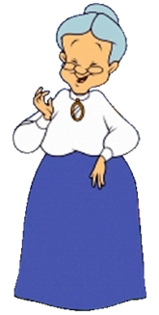


Clear, Concise, and Compelling Communications
So Tommy, what does your new company do?
Blah, blah, blah, blah, blah…
What will she hear, remember, and tell others?.
23
Notes:
A good test for your message is to imagine that it is Thanksgiving and you just arrived at your grandmother’s house. You find her in the kitchen with hot gloves, carrying a pumpkin pie she just took out of the oven. One of her grandchildren is pulling on her apron, trying to get her attention, while others are hustling and bustling around. She turns to you and says: “So Tommy, I understand you just started a new company. What does it do?”
How are you going to answer her with something that she will hear, understand, and remember?

Slide 24



Was it Clear?
“Is Shakespeare on the test?”
…and the teacher said…
Concise
Clear
Compelling
“Know Shakespeare”
…or was it…
“No Shakespeare”
24
Notes:
People are terrible mind readers. What they hear may be markedly different from what you say or intend. There is a classic story about the students in a Freshman English Class repeatedly asking their professor what would be on their final exam. She kept dodging the question until she was halfway out the door. She turned and gave them a hint. Half the class heard one thing, and the other half heard another. She was concise and compelling, but not clear. What would you have done?

Slide 25


Finally: The Only Validation that Counts!
Did they buy?
Problem Discovery
Prospect Discovery
Buying
Customer Discovery
This means:
They saw value in your offering.
It was high enough versus other choices.
They have confidence in you!
Notes:
The first two categories of Customer Discovery, Problem Discovery and Prospect Discovery, are based on your opinion and those of the prospects. The third level, Buying Customer Discovery, is based on action, not words. Did they buy? If they did, your solution resonated with them and was important enough for them to act. All of us, in our personal and professional lives, constantly make choices about where to spend our resources, whether time, money, or both. Receiving an order from a customer clearly demonstrates the customer has prioritized you over many other options.

Slide 26
Customer Discovery
THE most important activity for EVERY entrepreneur!
Problem Discovery
Fully define the problem, the pain points that you are SOLVING, and what it will take to implement.
Prospect Discovery
Meet with prospects one-on-one, understand what they are doing now and how important the issue is to resolve with your solution.
Buying-Customer Discovery
Did they buy from you! (The only discovery phase that matters.)
“You are solving a problem that prospects agree needs to be solved now and are willing to pay you for it.”
Proper
Fit
Notes:
Most experts talk about Customer Discovery. It is, in fact, the most important, but it only comes later. It is very easy to measure – did the prospects buy from you? The first two forms of discovery must be addressed first.
Probably the most common error entrepreneurs make is focusing on their super-duper solution to a customer’s perceived problem. They become so infatuated with their solution that they do not carefully research and understand the customer’s actual problem and how it impacts their business.
The lack of adequate problem discovery often results in misleading prospect discovery. The often-recommended advice to talk to hundreds of customers will never help if you focus on the solution instead of the problem.
Once the process is complete and customers buy, you can feel confident your offering meets the critical test of Proper Product-Market Fit. Most startup failures can be attributed to not attaining that simple goal.
It is positive proof that you have met all of the requirements of the quoted statement.

Slide 27


It is All or Nothing!
Are you solving a problem that prospects agree needs to be solved now and are willing to pay you for it?
You
Solving
Problem
Prospects
Agree
Now
Pay
You
All issues need to be addressed.
Notes:
The simple, 21-word statement has eight separate, equally important elements. Missing any one will stop the flow of revenue. The elements are:
You: Not someone else.
Solving: You need to solve it, not just partially address it. If you have to rely on others for the complete problem solution, you do not have control – someone else does.
Problem: The problem or condition must be real in the minds of the prospect and must be worthy of addressing.
Prospects: It does not matter how convinced you are about the problem and your solution. Only the prospect’s perspective is important.
Agree: Prospects must agree that the problem or condition needs to be addressed. Ignoring it is not an option.
Now: The prospect needs urgency to address the problem now, not “sometime later.”
Pay: Are prospects willing to pay for the solution at a price that makes sense for you? They will have to consider all of the other costs that they will incur in making their decision.
You: In this context, it means paying you, not someone else. You may have done an excellent job at making the prospect aware of the need to solve the problem only to find out they will select someone else! Be sure the prospect knows and believes why you are the best choice.

Slide 28

Think Objectivity
Am I really sure?
Validate the problem:
  Is it real?
  Is it worth solving?
  Now (instead of others)
  Will they pay for it?
Validate the solution
Can I make money?
How will I create awareness?
To whom will I sell it?
How will I sell it?
How will I satisfy customers?
How will I support them?
Find a mentor!
I need to answer these questions
I could use some help, but from who?
Who will:
Listen
Guide
Coach
Objectively!
28
Notes:
Thinking objectively about the problem and your solution could be the hardest task an entrepreneur faces. Quite simply, they want to believe that what they have uncovered and solved is the best approach. It is very easy to rationalize your position unconsciously. Questioning one’s self is very difficult.
Instead of validating these issues, ask someone else for objective feedback. That person is unlikely to be a friend or relative. Those individuals, although well-intentioned, will be biased toward supporting you and telling you what they think you want to hear instead of the, perhaps, brutal truth.

Slide 29



Mentor
Half Leader – Half Guardian Angel
Their goal is to help you be successful
– not to make you feel good.
They will help you:
Identify what you do not know.
Identify what you should do, when.
Identify what you should NOT do.
Stay on track (remain focused).
Mentors should:
Do it for free
Have startup experience
Be available
Be candid
Help in all 8 areas
Prioritize your activities.
Find the necessary resources.
Be accountable.
Determine if/when you should pivot.
They will help you avoid mistakes!
Notes:
Probably the biggest factor affecting an entrepreneur's success or failure is the effectiveness of their mentor and their ability to provide proper guidance. Their heavy involvement will not necessarily guarantee your success, but their absence will almost certainly guarantee failure!
Find a mentor early in the journey. They will be most valuable in the early days of Customer Discovery. With that involvement, they will have the background to guide you during your entire journey.

Slide 30





Along the Journey…Entrepreneur’s Role Changes*
From “E” to “C”
Visionary Evangelist
Relationship Builder
Manager of Execution
Problem
Solution
Team
Resources
Phase →
Solidification
Validation
Coming of Age
Entrepreneur -->
Chief Examination Officer → Chief Everything Officer
Chief Expansion Officer → Chief Evangelist Officer
Chief Execution Officer → Chief Executive Officer
Role →
* from “Founders Keepers” by Hagberg & Tzuo
Notes:
There is an outstanding book, “Founders Keepers,” written by Hagberg & Tzuo, which should be mandatory reading for every would-be entrepreneur. It identifies three trails based on real-world experience. With this knowledge, an entrepreneur can assess their capabilities as their role transitions. “Going it alone”” may seem like the “macho” thing to do, but the reality that few successful entrepreneurs do it single-handedly.

Slide 31
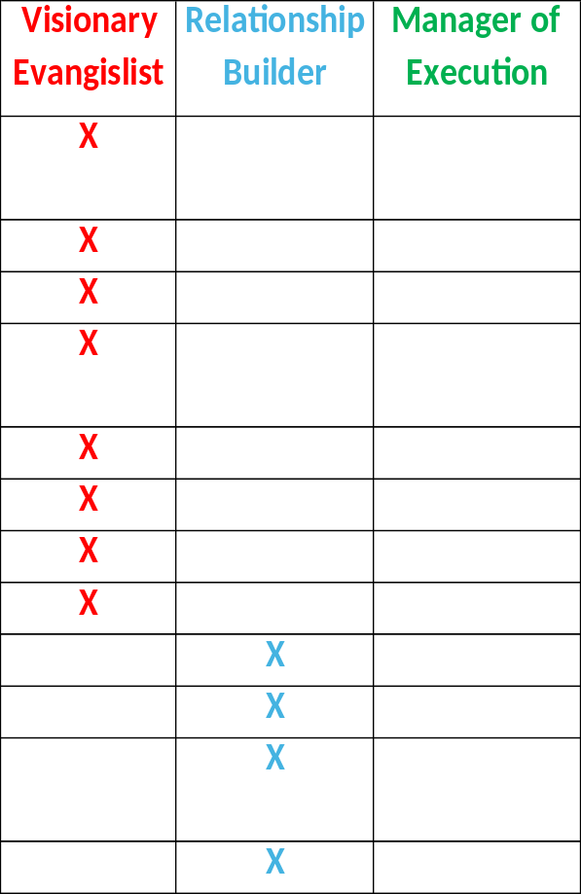
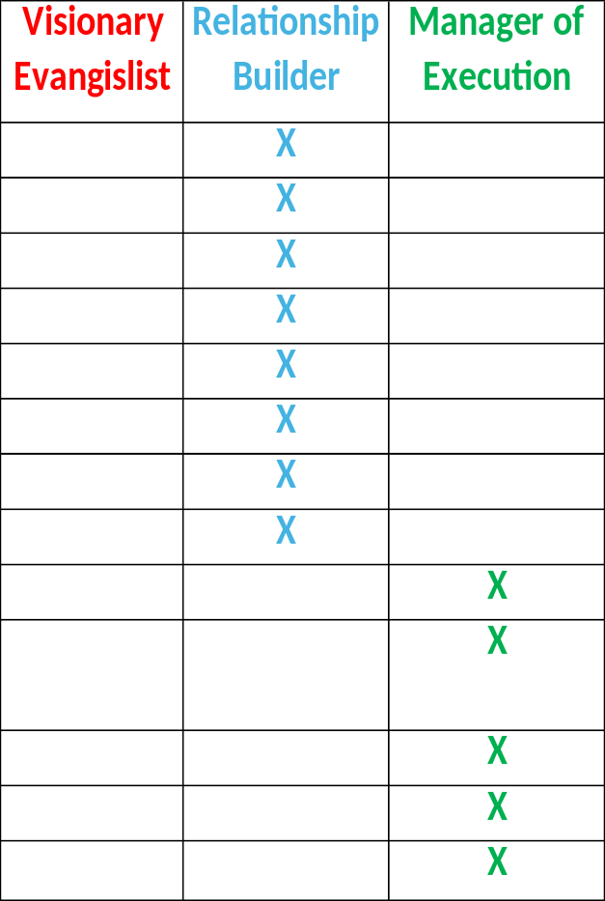
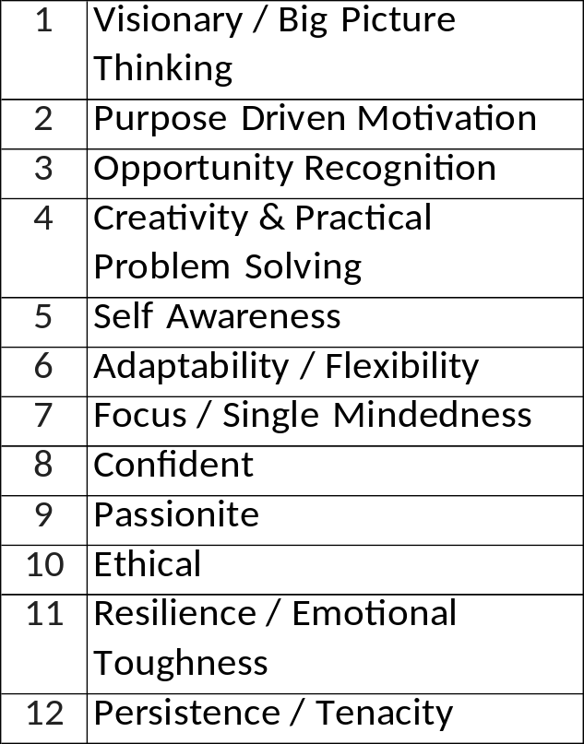
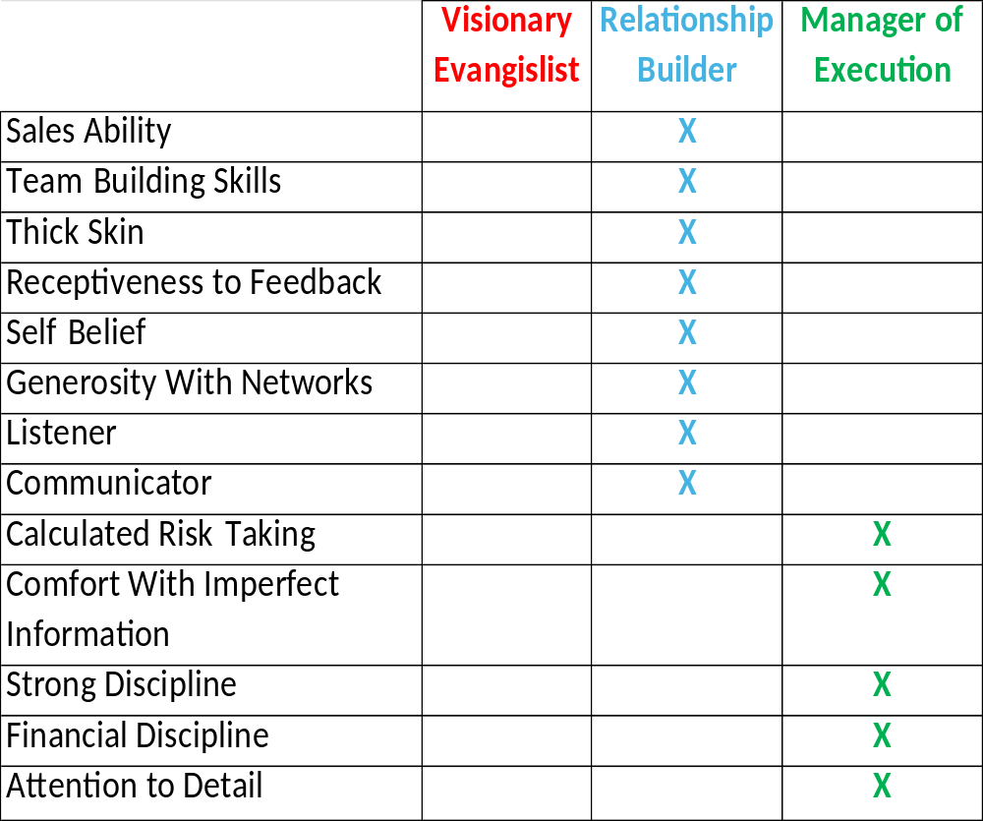
What Are Your Best Attributes?
Required Skills
Notes:
Although the list of traits is long, try to identify which ones aren't important. Not having all of them isn't necessarily an issue, but not addressing them is. Look for help!

Slide 32
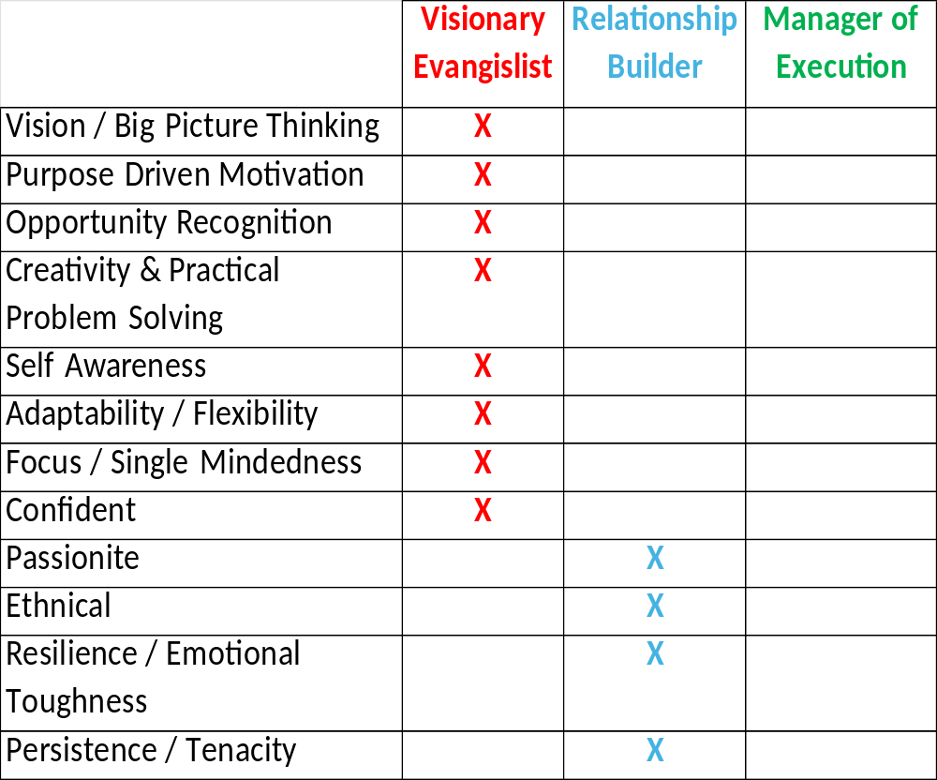


You Can’t Do It Alone!
A Mentor can help with your assessment…
Do you excel at all three?
Hire Your Opposite(s)
?
?
?
Few of us do!
Different skills will be required along the journey.
Someone:
Needs to set the Destination
Coordinate the Resources
Manage the Route
While they guide you on your journey.
Notes:
Again, objectively identifying your strengths and areas in which you need help is critical. A mentor can help with this task. Many of us can learn most of these traits – given the time to do it. However, time is the one commodity that is not fungible – once it is gone, it is gone. The best approach is to find others to fill in your voids. There is nothing to be ashamed of in asking for help. In fact, it is a sign of strength and confidence.
This approach is easy to validate. Ask any successful business person if they did it alone or relied on others for help. The answer will always be the same.

Slide 33



What should I do?
Then…
School Must Come First!
Jump In!
Start the Journey!
Think of this as the Pre-Season
A time to try things and learn.
What problem should I tactical?
←Experience
Education→
You’ll have to get out of your comfort zone and learn new skills.
You’ll have to do things you’ve never done before.
It’ll help prepare you for your future.
Valuable whether you start or join a company
Notes:
Jump in and commit to start. Your goal should be to learn. It will be an eye-opening experience, and you'll learn what you never thought about. Do not become discouraged. Think of this as a pre-season; a time to develop and hone skills. Even professional sports teams go through a pre-season period. Plan on stumbling. The key is to reground and try again. Through this process, your experience will help you learn far faster and more deeply than if you just study entrepreneurship from the outside looking in.

Slide 34
Your Initial Entrepreneurial Challenges
Pick an opportunity that interests you – the size and scope do not matter. This is all about learning.
Clearly and concisely defined and validated the situation (problem) that you are addressing.
Have a simple way of explaining how you will help the customer meet their (not your) goals.
Be open to negative feedback and course corrections.
Working with others that will provide honest feedback.
BE willing to “regroup” or start over with something else.
34
Notes:
So, here is your challenges in identifying an opportunity. Once the idea pops into your head, write it down, then begin writing answers to these questions. Do not fall into the trap of “thinking” about answers – write them down.
When you are satisfied with your answers, share them with someone who will give you candid feedback. It is better to find flaws early than later.

Slide 35
What to do #1?
School MUST COME FIRST!
Develop real time face to face communication skills
  Learn how to REALLY listen and hear what is being said and not said
  Learn how to speak clearly and concisely
  Observe and ask why and also ask why not
Think about what you are good at and what you enjoy
Look for problems that you find interesting and would like to pursue
  Answer the question “I could do it, but should I?”
  Formulate the problem and your intended solution
  Socialize both
  Look for honest feedback
Notes:
Once you start, the tasks can feel overwhelming. Couple that with your enthusiasm, and it will be easy to put your entrepreneurial journey ahead of school – Don’t! Only work on your business when all of your schoolwork is done. One of the most important skills that you can learn and it applies to virtually every activity you will be engaged is from now and forever, is the ability to truly listen to others. Listening is the most important half of the battle. The other half is to speak clearly and concisely in a way that is appropriate for your audience.
Find an opportunity that you feel you will enjoy pursuing. Passion is the major ingredient that will keep you going when times get tough.

Slide 36
What to do #2?
Find a mentor, share your ideas and LISTEN!
  Ask for their candid opinion
Investigate and then validate the problem with prospect
  Pivot if necessary
Realistically evaluate your solution and what it will take to implement it
  Can you do it while in school?
Determine how you will make prospects aware of what you are doing
Find others to help you
Have fun while you learn!
Notes:
As soon as you select a business opportunity, stop pursuing it and find a mentor. This is an important first step. If you focus on developing your business first, you may become so invested that, by the time others point out potential issues, you may not want to stop. There is a saying in the startup world that applies directly: Fail fast. The reasoning is simple: minimize your investment in activities that will not be successful.

Slide 37
The Journey
“It’s got to be the going,
not the getting there that’s good.”
From Harry Chapin song: “Greyhound”
Notes:
Your entire journey has to be fun. Unquestionably, you will hit bumps in the road and have to regroup or, perhaps, totally start over. Every activity will be a lesson – some good, some bad, but you will constantly be learning. Many times along the journey you will look back and say “How could I have missed that?” Or “How could I have been so naive?” Think of every lesson as an arrow in your quiver. In the future, when a similar situation arises, you will “pull out” the lesson from your quiver and adjust your aim accordingly. There is no better way to learn than through experience.

Slide 38
Thank You!
Clear
Concise
Compelling
I hope I was Clear!
I was not Concise!
I hope I was Compelling!
Entrepreneurship: Is it right for you?
You won’t know until you try!
Notes:
This has been a long session. It was like drinking through a fire hose. It talked about developing new skills, which is always challenging. One message I want to keep in mind is to find a mentor as soon as you decide to travel up the entrepreneurship mountain.
Not everyone is cut out to be an entrepreneur. There are many alternatives to starting out on your own. In fact, I recommend that all young aspiring entrepreneurs start by working in corporate America first. The training, coaching, and experience you will receive will be invaluable throughout your career. When the time is right, take the plunge. The only way to find out if entrepreneurship is right for you is to try it. I have worked with almost 200 entrepreneurs over the years. Most were not successful. However, none of them ever said that they wished they had never tried. Successful or not, you will learn life-long lessons and be a better person because of it.

