Slide 1
Negative Thinking to Avoid Negative Results
with
A Simple Contingency Planning Tool
Aug 2022
Tom Berger | RDK Consulting, Inc. | tom@rdkgroup.com
Notes:
Despite are best plans and actions, bad things happen. Some of them are total surprises while some can be anticipated. Further, some of them we can control and some of them we cannot. This presentation discusses an approach to identify the things and events that, if we think hard enough, we can predict. It provides a simple numerical method to prioritize issues and events.

Slide 2
Observations on Risk
“There are many more things that can happen than will happen. This is the essence of risk.” (Elroy Dimson, London Business School)
Worry comes from risks. If your main goal is to avoid worry, you will always be poor. (Max Gunther, The Zurick Axioms)
Some things you can control, others you cannot, but you can always control how you chose to react to all of them. (Frank Wapole, “Trust: The CEO’s Currency for Success”
For today: Risks that are threats to your business
A simple tool to Identify them →Assess them → Manage them
Notes:
Unfortunately, in recent years all of us have become familiar with the concept of Black Swans. In this context, it refers to events or situations that took us totally by surprise. To be fair, others may have predicted them but most of us were unaware. Think of the impacts on the business community that each of these events has had. There were, of course, many others, and we can sure that more will occur in the future – when and where are the big unknowns.

Slide 3
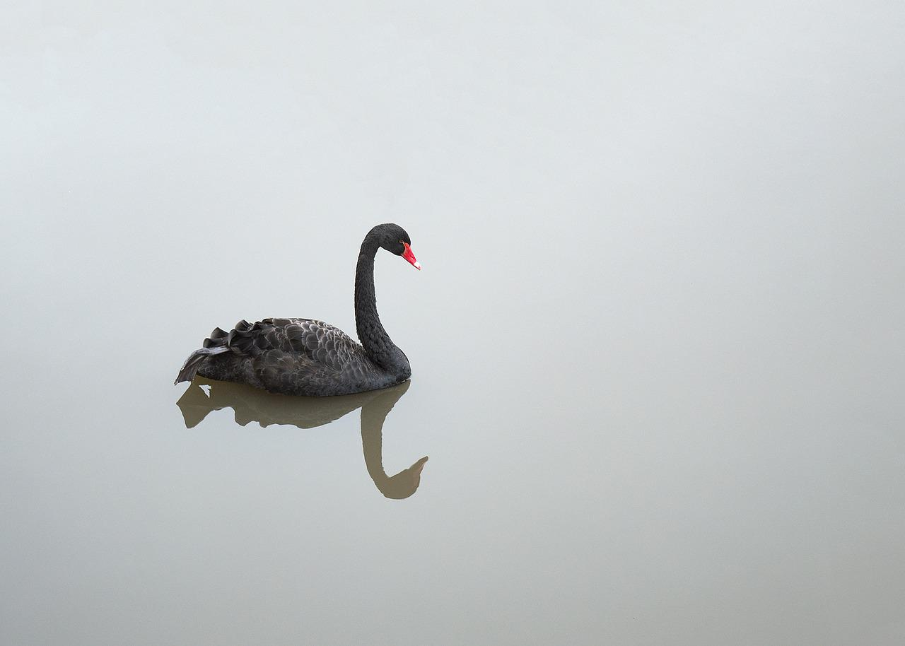
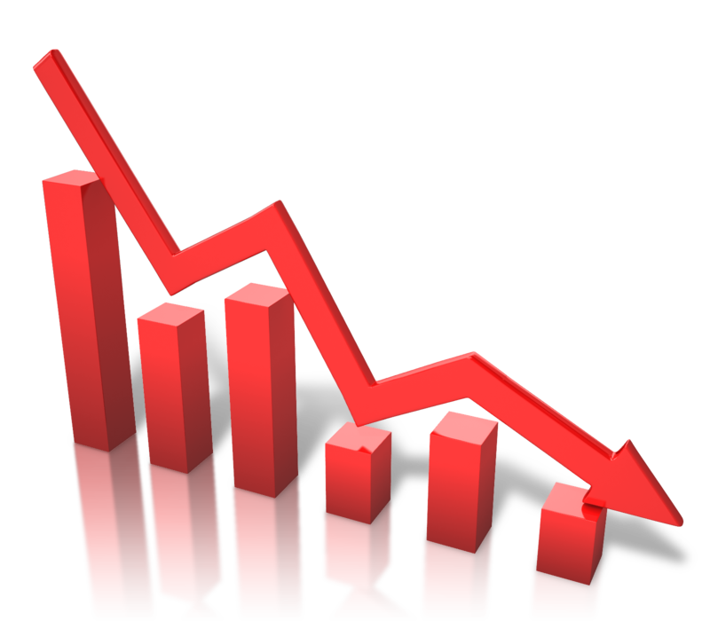
Surprises Do Occur
There was no such thing as a Black Swan until there was!
September 11th
COVID
Labor Shortages
Supply Chain Interruptions
Oil Prices
Notes:
Unfortunately, in recent years all of us have become familiar with the concept of Black Swans. In this context, it refers to events or situations that took us totally by surprise. To be fair, others may have predicted them but most of us were unaware. Think of the impacts on the business community that each of these events has had. There were, of course, many others, and we can sure that more will occur in the future – when and where are the big unknowns.

Slide 4
What to do…3 Choices
Ignore
React
Respond
Maybe it will go away?
What is it doing to us?
What is it doing to our customers?
“Wish Casting” replaces Forecasting.
Knee Jerk – the new corporate dance.
Can we weather the storm?
Should we seek a safe harbor?
Should be change course?
Notes:
When the unexpected or even the expected bad news occurs, there are three and only three responses that we can make.
Ignoring them seldom works. Negative issues are not like fine wine; they do not get better with age.
Thanks to being always online we seem to be deluged almost instantly with new information. Somehow, we have gotten into the habit of feeling that we must immediately respond to whatever stimulus we receive from anyone. Often, we do not have to think, but we often have plenty of time to regret our quick response. Reacting often leads us down the wrong path.
Responding is a timed-delay to knee-jerk responses. The difference is “think and reflect” time. Imagine the change in corporate culture if it were not possible to respond immediately to an email! Instead, the recipient would have to wait ten minutes! Productivity would probably jump up everywhere. The advice that we give our children to stop, look, and listen is equally applicable to all of us: stop, think, respond.

Slide 5
Fundamental Difference
Reacting
Responding
Strategy
Tactics
Strategy
Tactics
Pull Back, Delay, Wait and See, Hunker Down, Re-Evaluate
Address Today AND Plant the Seeds for Success
Notes:
Reacting invariably involves formulating quick tactical responses. Today, many companies are dramatically pulling back, expecting the worst to occur. Similar to consumers buying giant quantities of toilet paper!
Responding may result in taking the same quick actions as reacting but will be tempered with thoughts about the long-term impacts of those decisions. It is not hard to simply ask: “If we do this today, what will tomorrow’s impacts?” We often hear of “unintended consequences” when we really mean “unforeseen consequences” that were the result of not taking the time to think about what could happen. Someone always knows – take the time to ask them.
5

Slide 6
An Almost Universal Axiom
Revenue is always delayed,
but expenses occur right on time!
The normal knee-jerk reaction is to cut expenses.
Without revenue, cash preservation only delays the inevitable!
Can you hold your breath – indefinitely?
Notes:
Revenue delays are predicable; worst case never turns out to be worse enough! However, bills including rent, utilities, and salaries occur with almost one hundred percent predictability. When revenue storm clouds appear, or worse, when lightning strikes, we feel compelled to take immediate action by reducing costs.
The cost reduction process is predictable: An Excel spreadsheet listing expenses from highest to lowest is “examined” and cost-cutting occurs. The mechanical logic involves attempting to reduce cost that provide the “most bang for the buck” the quickest. Often, little thought is given to how to recover after the storm passes. For example, laying off contractors is a quick and easy step to take. However, will those same contractors with their institutional knowledge be available when you need them? How long will it take you to find replacements, and how long will it take them to get up-to-speed? The same considerations should be given to other programs. If, for example, you stop advertising or marketing efforts that you have consistently done in the past, what will prospects think? Will they assume that you have gone out of business?
On the other hand, slowing done a new product or a next-generation product that will not significantly increase short-term revenue may be entirely appropriate.
What is for certain is that looking backward at the business and past expenses is not appropriate. Instead, re-thinking where the business is today, where it is likely to be in the short-term, and what are the long-term implications should provide cost-cutting guidance.

Slide 7



Where is Your Focus?
How am I going to survive?
Purchaser
User
You
Customer
Customer’s
Customer
Notes:
In times like these, the first thought is always about survival as it should be. In fact, the first principle is my list of Seven Business Principles is “Stay in Business.” I adopted the Seven Business Principles over twenty years ago and have them printed on the back of my business card.
Invariably, for small cash-starved companies, survival is equated to cutting costs. To be fair, when the coffers are empty, it is hard to stay in business! However, one cannot save their way to profitability; it’s all about revenue.
In today’s crisis environment, there may be other sources of cash: SBA and special government-backed loans, delayed vendor payment, vendor financing, and ask for cash with order or for advances may all be possible. One thing is for certain: If you don’t ask, you won’t get it!

Slide 8

Where is Your Focus
How can I get more business?
You
Customer
Customer’s
Customer
Notes:
Once a company comes out of their shell-shocked state, they begin to focus on revenue – the most obvious source of cash required to sustain operations. However, customers may be in the same internally focused state and not willing to consider your offering; they are too busy trying to state in business. Who can blame them?
Continuing with your business, using your tried and true past successful approaches, probably won’t work.

Slide 9
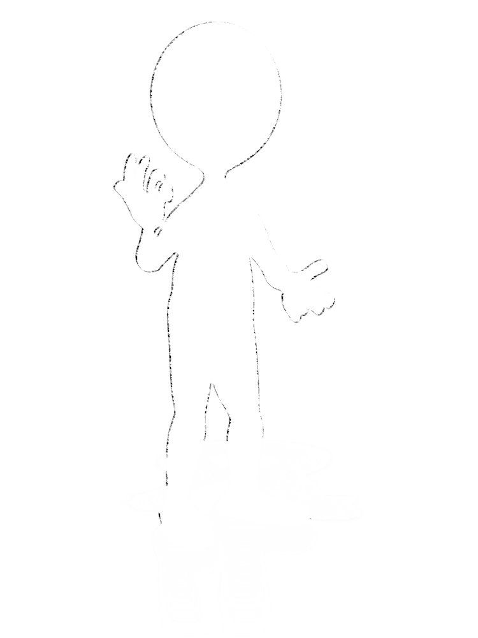

Where is Your Focus
What can We do together to satisfy YOUR customer?
You
Customer
Customer’s
Customer
Notes:
As mentioned before, move to within the “customer’s box.” Focus on their efforts to be successful with their customers. Remember, the customer’s customer may be an internal group.
Don’t simply take up space in your customer’s box. Avoid being a distraction; figure out how to provide true value-add that is readily apparent to customers.

Slide 10

“Dust Bowl” Circa 1930s
1930 Revenue: $63M
1932 Revenue: $8.7M
1931 Laid off 75% of Work Force
Most farmers defaulted on their loans.
"At some point, the weather will improve and you will need your tractor. Pay us when you can."
Notes:
John Deere’s actions in 1931 is one of the greatest success stories of all businesses. Their one decision had a profound impact on this entire nation. The impact that it had on individual farmers in the Midwest and Plains states has been passed down through generations. It was clearly an unnatural act and flew in the face of every business principle.
It will be interesting to see if some of today’s giant corporations develop a loyal following like John Deere. How do you feel about your loyalty to airlines, hotel chains, cable companies, cellular companies, and others?

Slide 11


“We Are Never in Control…
…but we can choose how we will respond to any situation.”
When the bomb explodes…
Is it Fatal?
Drop what you are doing.
Verify the impact.
Address it.
Y
N
Count to 100 by seventeens.
Take a deep breath.
If we do this, what will be impacted?
Notes:
There is a remarkably simple and yet profound notion, put forward by Frank Wapole, retired Motorola Executive, and CEO, that is the key to differentiating between how we behave and how we respond. It involves the realization that we can control very few of the events around our lives. But what we can do is decide how we will respond to those events.
Clearly, the current COVID-19 crisis falls into that category. However, the same lack of control occurs all around us: CEOs can demand, but others perform the tasks – sometimes right, sometimes not. Customers have different priorities and do not ask for your permission to change them. Competitors launch new products when it is to their advantage, not yours. The list goes on and on.
When an event occurs, first ask how should I choose to respond?
There is a simple process to follow when the terrible news appears. If the situation could be fatal to the company, drop what you are doing and respond. If not, slow down and think about the impacts of your potential response. If you give the new issue priority, all of your other activities automatically drop a notch. Is this what you really want to happen?

Slide 12



Winning Hand?
You have to play the cards you were dealt.
Notes:
I was Chairman and interim CEO of a telecom startup during the telecom bubble. Our prospects universally pulled back. Our short-term outlook looked bleak. Moral was low. I pulled my senior staff together and announced we were going to play poker. I then dealt the cards to the team.
After everyone looked at their cards, I asked: “Who has a Royal Flush?” No one did. Then I asked: “How has four of a kind?” Again, no one did. I then showed them my hand and asked everyone to show theirs. I then said: “We have no choice but to play the cards we are dealt. Let’s figure out how to turn each of these into winning hands.”
By the way, my pair of fours was beaten by a pair of nines.
Two and a half years later, we sold the company for ninety-five million dollars. We were successful for one reason; I got out of the way and let the smart and motivated people figure out how to win.
I kept my hand. It is in my top desk draw; I look at it and reflect on it often.

Slide 13



Most Surprises Aren’t!
People do not openly talk about bad news!
If not threatened, they will tell you.
You have to ask.
Someone knows!
Notes:
There is a culture in business to not talk about bad news. If someone does, they are labeled as not being a team player. So, the herd of elephants in the room are often ignored. It is simply not OK to acknowledge trouble or its potential. Many times a development team will have their own forecast that differs significantly from the “official” forecast. The sale with sales.
This situation and a realistic view can be obtained simply by asking people in a non-threatening or judgmental way of what could go wrong. They will tell you.

Slide 14
Ask Three Things (sequentially)
What could happen?
Internally / Externally
Immediately / Later
Recoverable / Nonrecoverable
What would be the impact?
What is the likelihood?
Notes:
The process is remarkably simple: Just ask three questions sequentially. Reserve all comments and judgement. Take the inputs as well-meaning concerns that may or may not be valid.

Slide 15

What could happen?
Ask people with different perspectives from different disciplines.
What could happen?
Impact and Likelihood should not be considered.
Notes:
Be sure to ask people from different levels and disci0plines. A worker on the factory floor may have insight that no one in the C-suite ever thought about. The sales with sales reps and are close to customers. We often hear that it is lonely at the top. The “top” is always isolated as well.
When asking the “could” question, do not talk about either of the other two factors. There will be time for that later.

Slide 16
Some Examples…
New competitor appears.
Key people leave.
Run out of money.
Sales cycle is longer than expected.
Product costs are higher than forecasted.
Possible patent infringement.
Distribution partner does not fulfill obligations.
Significant field failures.
Funding takes far longer than anticipated.
Excessive discount pressure from prospects.
Prospects reluctant to move forward.
Government regulations require changes.
System integration more difficult than anticipated.
Notes:
This is a sampling of several business-related issues that may apply to any company. Of course, this list just scratches the surface of the impediments that could occur. The unknown impediment is a Black Swan event. By definition, they cannot be predicted. Think about the impact of 9/11 on us. As one example, I was working with a young startup in Fort Lee, New Jersey. Their office was almost in the shadow of the World Trade Center. They planned to announce their first product on 9/11. COVID-19 is today’s example.

Slide 17
Process
What could happen?
1 Do this first…
What would be the impact?
2 Then this…
What is the likelihood?
3 Then this…
4 Then “Rinse and Repeat.”
Notes:
It is important to methodically follow the process as outlines. Document all of the “could happen” items first before examining the impacts and likelihood of each. Do not be surprised if more “could happen” issues and events come to mind while documenting the impacts and likelihood.
As an example, one possibility is that a key developer leaves. The immediate impact might be that the next release is delayed. With that delay, revenue may be delayed and cash availability reduced. This in turn, may result in not being able to hire a replacement for the person that set off the chain of events.

Slide 18


Same as Goal Setting Exercise
Allocate one uninterruptible hour.
Gather some people (w/o phones/laptops).
Repeatedly answer the questions:
Could Happen, Impacts, and Likelihood
Do not focus/discuss on actions or solutions during this session.
Notes:
The key to the success of this approach is the buy-in from all participants and their undivided attention. Some individuals, with their naturally optimistic attitude, may think that it is a waste to time. Others may be afraid of admitting their vulnerabilities to a larger group.
These sessions are not “fix-it” sessions. Planned action items to monitor the situation and actions to be taken to both avoid and recover from the issues and events require different sessions will, perhaps, different people.

Slide 19
Exercise Mechanics
Ask for individual responses, in order, sequentially.
One, short answer at a time, on one activity or metric.
Write down every response.
Do not allow any discussions (except for clarifications).
Everything is fair game.
Only eliminate redundant inputs.
Repeat until no new ideas are shared.
Notes:
The process is simple. The only difficult part is keeping it simple! There is an almost overwhelming desire to discuss and debate each other’s statements and jump to solution discussions. Everyone needs to help enforce the discipline of capturing items as they are stated, hopefully with only a few words.

Slide 20



Repeat the Process
Add Likelihood
for each
item.
Add Impacts for each item.
Notes:
Although I will describe a tool to use to document this process, it can be done with almost anything from sticky notes, easily sheets, someone acting as a scribe, or with a software tools.

Slide 21
Create a Rating System
Adds a level of objectivity
Quantify the Likelihood and Impact of each Impediment.
Risk Likelihood
5 = Unknown
4 = High
3 = Medium
2 = Low
1 = None
Business Impact
5 = Fatal
4 = Unknown
3 = High
2 = Medium
1 = Low
Notes:
A rank order, numeric rating systems helps to add a degree of objectivity to the analysis.
This step involves examining the potential list of impediments previously developed and assigning two numerical values to each. Using a whole number grading system as shown provides a method of prioritizing the impediments. Whole number granularity is all that is required. When establishing the various grades, expect differences of opinions. In the scheme of things do not argue if there is a one-point difference. However, if there is a significant difference, say a 1 and a 4, probe to understand why both grades are being proposed. It could be that some individuals have better insight than others or some have historical biases. In any case, avoid compromise grades; obtain agreement.

Slide 22
Helps to Set Priorities
Only “helps”
Risk Likelihood
5 = Unknown
4 = High
3 = Medium
2 = Low
1 = None
Multiply
X
X
X
X
X
Business Impact
5 = Fatal
4 = Unknown
3 = High
2 = Medium
1 = Low
Result
25
down
to
1
Notes:
Multiplying the Likelihood and Impact grades together will provide a rank order of impediments.

Slide 23
Investigation Rank Order
Risk Likelihood
5 = Unknown
4 = High
3 = Medium
2 = Low
1 = None
Multiply
X
X
X
X
X
Business Impact
5 = Fatal
4 = Unknown
3 = High
2 = Medium
1 = Low
Result
25 to 16
Focus
Ignore
4 to 1
Notes:
The result is a listing that can be sorted by highest total to the lowest total. Every organization has limited resources, it is highly unlikely that any company could address every possible risk. Instead, focusing on the potentially fatal issues with the highest likelihood makes sense.
Prioritizing the Unknown Likelihoods and Impacts is also important to avoid potentially nasty surprises. In these cases, replacing the “unknowns” with factual data is critical and then reprioritizing the list accordingly.

Slide 24
More Considerations
Example of Per Item factors…
Category
Business Impact
Who Has Control
Status
Application
Business
Product
Technology
Distribution
Competition
5 Reduced Viability
4 Reduced Mkt Size
3 Delayed Revenue
2 Reduced Margins
1 Increased Costs
5 Competition
4 Market
3 Customer
2 Technology
1 Company
5 An Issue
4 Open
3 Unknown
2 Resolved
1 Not Applicable
Notes:
It can be useful to include other factors for each identified risk. This list was created for a company that I was running. Other items or other considerations may be important to other organizations.

Slide 25
Other Things to Capture
Making it part of the management culture.
Who will be responsible for watching this issue?
What should they watch for?
When should they report back to the group?
Should the ratings and other info be changed?
Are there others that should now be involved?
Promote openness
Breakdown silos
Teamwork
Shared goals
Notes:
By adding a few more data fields, the risk analysis methodology can become a useful management tool and impact the entire culture of the organization. It can involve individuals at all levels in all areas of responsibility. It will help to establish common goals and a feeling that we are all in this together.

Slide 26
How to Implement
Make it easy to capture, update, and understand.
Simple text document
PowerPoint™
Excel™
Etc.
Should be used by Managers to manage the business.
Not an Admin or IT tool.
Notes:
It is not hard to implement this system. In fact, virtually any paper or software product can be used. The most important implementation issue to consider is that this should be a working tool used by operational people to help run the business.

Slide 27
PowerPoint™ or Word™
Item | Risk | Severity | Weighting | Who
Given other priorities, prospects are willing to buy our solution now. | 5 Unknown | 5 Fatal | 25 | Tom
Standard solution is acceptable, no customization req’d. | 5 Unknown | 3 High | 15 | Dick
We can recruit and retain key people when needed. | 3 Medium | 5 Fatal | 15 | Harry
Single source components remain available. | 3 Medium | 5 Fatal | 15 | Alice
We can stay under the radar screen of competitors for now. | 4 High | 3 High | 12 | Pete
Other fields:
Controlled by
Primary Impact
Secondary Impact
Status
Metric
Update When
Previous Weighting
Notes:
This is one example, using PowerPoint™. Even the “who” column is optional. Other data fields can easily be added.

Slide 28
As Detailed as Required
Radio interference will not significantly impact the performance of our system.
Our solution is applicable to "most" incidents and is viewed as more effective than the (flexible) manual processes in use today.
Initially assigning personnel to Units and assignments after they arrive on scene is practical (No pre-assignment are req'd.)
Personal information (stored in the RSN) is viewed as high value versus device information associated with a person's position. (i.e Assigning a unique RSN to an individual is attractive.)
Distributed and transfer of command is not required for us to meet our initial sales goals.
56 Risks Identified: 3 @ “25” and 14 @ “15”
Notes:
The risks can be very specific and, in fact, should be. This is an example of some of the risks that a company faced with their new product intended to track the activities of first responders at the scene of an incident. The company identified fifty-six risk factors. Three of the risk factors had weighted scores of 25 and fourteen had weighted scores of 15.

Slide 29
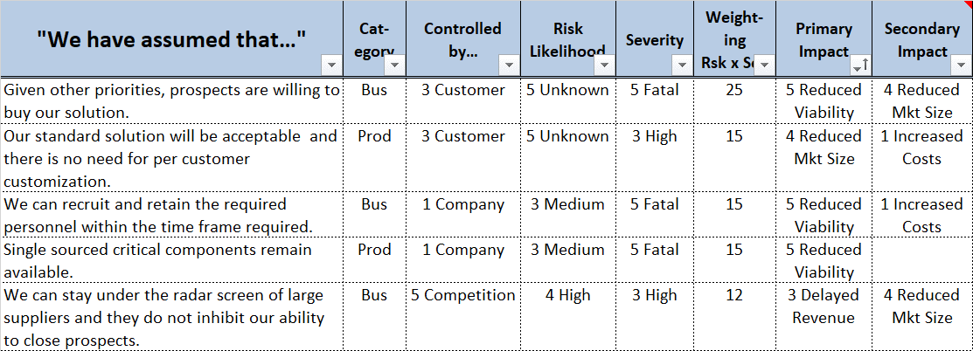
A Tool Example
Notes:
This chart shows a snapshot of a tool that is available on the CxO-Altas website. It is a simple Excel™ workbook. Registered site users can download it and the associated user guide.
It is an Excel™ workbook Three versions are available: The Advanced Version as shown, a Basic Version, and a version that can be used as a training guide.
Several years ago, I became involved in a startup that had recently been funded by three highly respected venture capital firms. I knew the space fairly well and conducted a risk analysis. I identified 17 issues that could negatively impact the company. Within a few months, 13 negative impacts did occur, 2 turned out to be non-issues, and the remaining two were unknown. The investors correctly pulled the plug. It turned out to be the right thing to do, although it was difficult for the founders to accept when the decision was made.

Slide 30
Demo Example Tool
Row # | "We have assumed that…"
1 | Issue 1
2 | Issue 2
3 | Issue 3
4 | Issue 4
5 | Issue 5
Row # | "We have assumed that…" | Cat- egory | Controlled by…
1 | Issue 1 | Bus | 3 Customer
2 | Issue 2 | Bus | 4 Market
3 | Issue 3 | Tech | 2 Technology
4 | Issue 4 | App | 3 Customer
5 | Issue 5 | Comp | 4 Market
Row # | "We have assumed that…" | Cat- egory | Controlled by… | Risk Likelihood
1 | Issue 1 | Bus | 3 Customer | 4 High
2 | Issue 2 | Bus | 4 Market | 4 High
3 | Issue 3 | Tech | 2 Technology | 2 Low
4 | Issue 4 | App | 3 Customer | 5 Unknown
5 | Issue 5 | Comp | 4 Market | 3 Medium
Each worksheet adds another data column for each identified risk.
Row # | "We have assumed that…" | Cat- egory | Controlled by… | Risk Likelihood | Severity | Weight- ing Rsk x Sev
1 | Issue 1 | Bus | 3 Customer | 4 High | 5 Fatal | 20
2 | Issue 2 | Bus | 4 Market | 4 High | 3 High | 12
3 | Issue 3 | Tech | 2 Technology | 2 Low | 5 Fatal | 10
4 | Issue 4 | App | 3 Customer | 5 Unknown | 3 High | 15
5 | Issue 5 | Comp | 4 Market | 3 Medium | 1 Low | 3
Notes:
These are snapshots of some of the worksheets included in the training guide version of the tool.

Slide 31
What makes this process NOT work?
Denial: Nothing bad will happen.
Fear of Retribution: Others will be mad if I say anything.
CEO Dominance: Lack of “equal” participation.
Check the Box Mentality: We did the exercise, just put it on the shelf.
Fear to Admit to Others: Investors and others may get skittish.
CEO Lip Service: You guys do it, I am too busy.
Water Cooler Complaining: No one brought up XXX.
Fear of Failure: Let them find out later.
Ultra-Conservative – “No Miss” Goals: I won’t be the problem.
Too Busy to Follow Up: Tactical stuff gets in the way.
Notes:
The process is remarkably easy to implement but can quickly be derailed by any number of conscious or unconscious acts by almost anyone involved in the process. The most critical element is the involvement and total support of the CEO. They must set the standard for everyone else to follow.

Slide 32
This presentation is available on…
www.CxO-Atlas.com
An absolutely free website with hundreds of short articles on starting and running a business.
Just register, select the article, and download it.
Article 8.040407
Notes:
This presentation with the slide notes is available on the website.

Slide 33
CxO-Atlas Website Article Organization
Title -> Quick Summary -> Abstract -> Article
~ 850 Words, 2 Pages, Read in 2 to 3 Minutes
STAGE
Thinking about starting a business
Committed to starting a business
Working full time in a new business
Has a demo product or service
Needs to raise money
Has some customers
Ready to expand
Having operational issues
Pursuing revenue
Access by
ACTIVITY (Volume)
Introduction and Overview
Seven Principles
Starting a Company
Managing a Company
The Top Line
Support and Development
Governance
Tools and Presentations
Everything Else
View Sequentially
Search by:
Title
Number
Key Word
Browse
Read
Download (PDF)
Anyone can browse and view Article Abstracts.
Members can view and download all content.
Members can interact with private AI chatbot based on site’s content.
689 Articles, 9 Volumes, 43 Chapters, 2,300 Pages, 872,065 Words as of 01/15/2025
Notes:
The CxO-Atlas website content is free to browse and read each Article’s Abstract. Members can browse, read and download any of the articles, tools, or presentations on the site. Members can also interact with a private AI chatbot by asking questions and then interacting with the responses. The chatbot’s responses are based on the site’s uploaded content.

